Slide 1
Comprehensive Penetration Testing for TechShield
.
An in-depth assessment of network infrastructure and web application security
Prepared by: Davinder Kaur
Notes:
Good [morning/afternoon], my name is Davinder Kaur, and today I’ll be presenting the comprehensive penetration test we conducted for TechShield. This project focused on assessing both the internal network and web applications to identify exploitable vulnerabilities and demonstrate their potential impact.

Slide 2
PROBLEM STATEMENT/CONTEXT
Objective
G0al
Assess the security of internal network and web applications.
Identify exploitable vulnerabilities and demonstrate potential impacts.
This comprehensive assessment aims to provide TechShield with actionable insights to strengthen their security posture against real-world threats.
Notes:
Slide 2: Problem Statement / Context
The goal of this engagement was to strengthen TechShield’s security posture against real-world threats. Specifically, we wanted to evaluate the security of their internal network and web applications, identify weaknesses, and provide actionable recommendations for remediation.

Slide 3
Project Requirements: A Deep Dive into Security Assessment
Engagement with TechShield covers a full spectrum of penetration testing, adhering to industry best practices and focusing on key areas of potential risk.
1
2
3
Network Discovery & Enumeration
Vulnerability Identification
Web Application Testing
Accurately classify and prioritize security flaws across the infrastructure.
Rigorous testing for common web vulnerabilities (SQLi, XSS, Command Injection, File Inclusion).
Precisely map the network landscape to identify all active devices and services.
4
5
Password Security Analysis
Forensic Evidence & Reporting
Assess the resilience of user authentication mechanisms against common attack vectors.
Collect detailed forensic data for comprehensive reporting and actionable recommendations.
Notes:
Slide 3: Project Requirements
To achieve this, the project included five key areas: 1. Network discovery and enumeration, 2. Vulnerability identification, 3. Web application testing, 4. Password security analysis, and 5. Forensic evidence collection and reporting. Together, these ensured a full-spectrum penetration test aligned with industry best practices.

Slide 4



A Phased Approach to Penetration Testing
Team methodology for TechShield's penetration test is structured into three distinct phases, ensuring a thorough and systematic assessment from initial footprinting to exploitation and reporting.
1. Reconnaissance
2. Target Assessment
3. Exploitation & Evidence Collection
Initial network discovery and mapping to understand the target environment.
Detailed vulnerability identification across identified systems and applications.
Demonstrating impact through controlled exploitation and gathering forensic evidence.
Notes:
Slide 4: Phased Approach
Our methodology followed three phases: reconnaissance, target assessment, and exploitation with evidence collection. This systematic approach allowed us to move from initial footprinting to exploitation while maintaining structured documentation.

Slide 5
Network Vulnerability Assessment: Phase 1 Discovery & Enumeration
Step 1: Network Discovery with netdiscover
Step 2: Service Enumeration (Using Nmap)
Notes:
Slide 5:The assessment involved two steps: Network discover and service enumeration

Slide 6


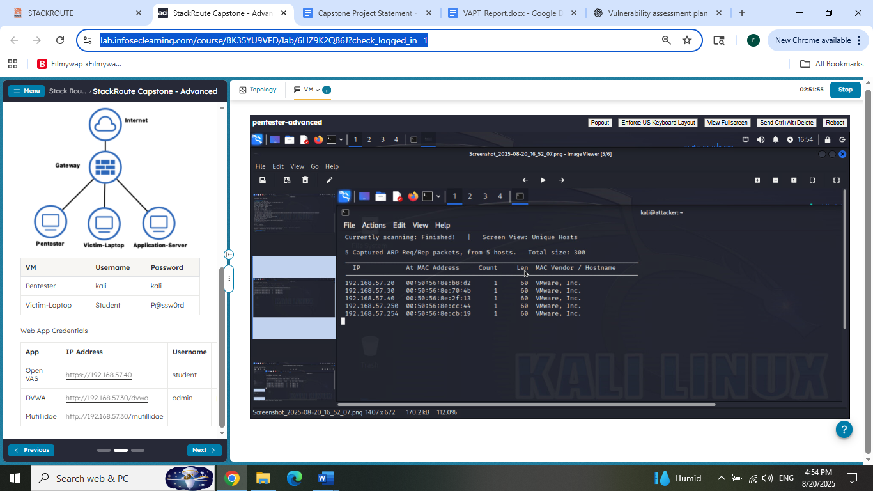
Network Vulnerability Assessment: Phase 1
Discovery
& Enumeration
Step 1: Network Discovery with netdiscover
Step 2: Service Enumeration with Nmap
Utilizing netdiscover for ARP scanning to map live hosts on the target network. This provides foundational insights into active devices and their configurations.
Leveraging Nmap to identify open ports, running services, and their versions on discovered hosts, crucial for pinpointing potential entry points.
Notes:
Slides 5–8: Network Discovery & Enumeration
In the reconnaissance phase, we first used Netdiscover for ARP scanning to identify live hosts on the target network.

Slide 7
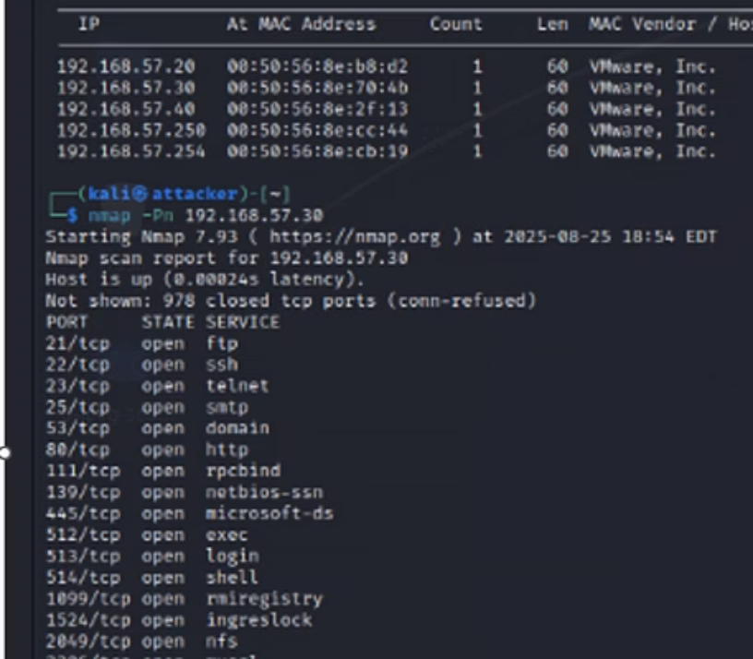
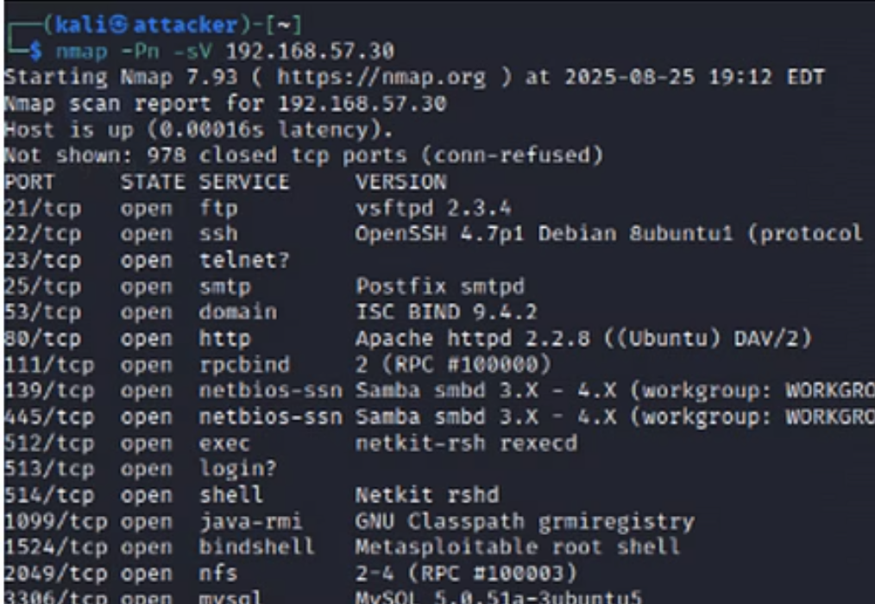
Nmap: Service Enumeration in Action
The Nmap tool is indispensable for gaining deep insights into network services. The following screenshots illustrate typical outputs during our service enumeration process, revealing open ports and running applications.
These outputs are meticulously analyzed to identify unusual open ports, outdated service versions, or misconfigurations that could serve as attack vectors.
Notes:
Slide 7: Here are the screenshots of open ports and running applications on the target machine

Slide 8
Step 1: Network Discovery with netdiscover
Our initial step involved an ARP scan using sudo netdiscover -r 192.168.57.40/24 to systematically map live hosts within the TechShield network segment. This process provides a fundamental understanding of active devices and their network presence.
Identified Services
Initial Network Map
Key systems such as 192.168.57.30 (Unix/Linux) and 192.168.57.40 were successfully mapped, revealing their IP addresses, hostnames, and MAC addresses.
All discovered devices and the scanned IP range were meticulously documented, forming the basis for the comprehensive VAPT (Vulnerability Assessment and Penetration Testing) report.
This foundational data is crucial for targeting subsequent vulnerability assessments and exploitation attempts effectively.
Notes:
Slides 8: We have discovered IP addresses, hostnames and MAC addresses of the active devices

Slide 9
Step 2: Service Enumeration with Nmap
Following host discovery, Nmap was deployed for detailed service enumeration, a critical phase for uncovering potential entry points by identifying open ports and the services running on them.
192.168.57.30 Analysis
Multiple open ports were detected, hosting services like Apache and SQL, indicating a broad attack surface that requires deeper inspection.
192.168.57.20 Analysis
Identified HTTP (port 80) and HTTPS (port 443) services running Nginx, confirming web server exposure and a common target for attackers.
Aggressive Scan Insights
Executing Nmap -A 192.168.57.40 provided comprehensive information, including service versions and OS details, enriching our understanding of potential vulnerabilities and configurations.
Notes:
Slides 5–8: Network Discovery & Enumeration
Next, we used Nmap for service enumeration, identifying open ports and running services. For example, on host 192.168.57.30, we detected a few hosting services, which expanded the attack surface.

Slide 10
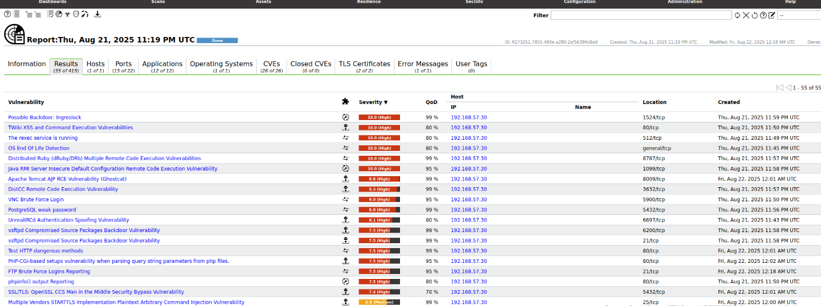
Scanning of 192.168.57.30 shows High risk Vulnerabilities
Notes:
Slides 10–11: Vulnerability Scanning
After discovery, we moved to vulnerability scanning using Greenbone Security Assistant (OpenVAS). This step systematically identified known vulnerabilities.

Slide 11
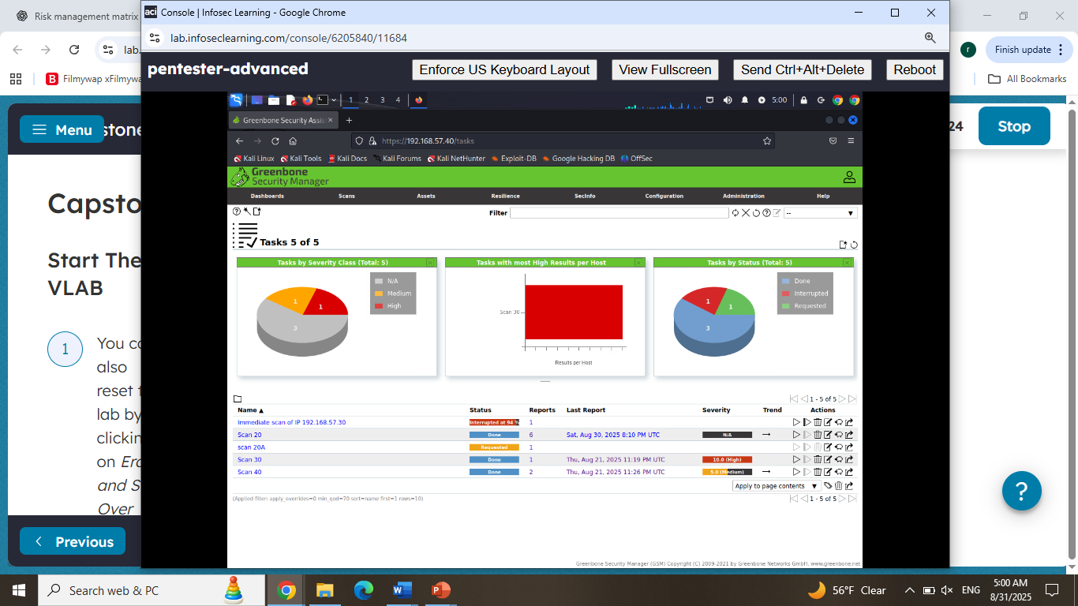
Network Vulnerability Assessment: Phase 2
Step 3: Vulnerability Scanning (Using Greenbone Security Assistant - OpenVAS)
In Phase 2, Greenbone Security Assistant (OpenVAS) was utilized to perform in-depth vulnerability scanning of 192.168.57.20, 192.168.57.30 and 192.168.57.40 This step is crucial for systematically identifying known security weaknesses on the discovered network assets.
High Severity Results for 192.168.57.30
The scan results for 192.168.57.30 highlighted several high-severity vulnerabilities, indicating critical weaknesses that could be exploited to compromise the system. These findings underscore the importance of prompt remediation.
Notes:
Slides 10–11: Vulnerability Scanning
On host 192.168.57.30, several high-severity vulnerabilities were detected, which we later prioritized in a risk management matrix.

Slide 12
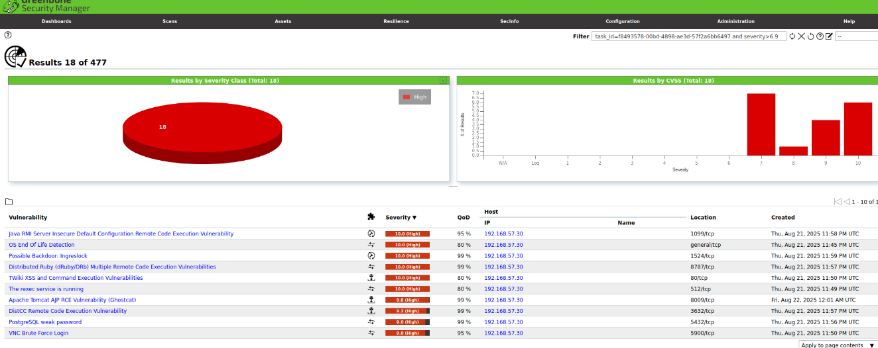
Network Vulnerability Assessment: Phase 2
Step 3: Vulnerability Scanning (Using Greenbone Security Assistant - OpenVAS)
High Severity results of 192.168.57.30
Notes:
Slide 12: A screenshot of high risk vulnerabilities are shown in this image

Slide 13
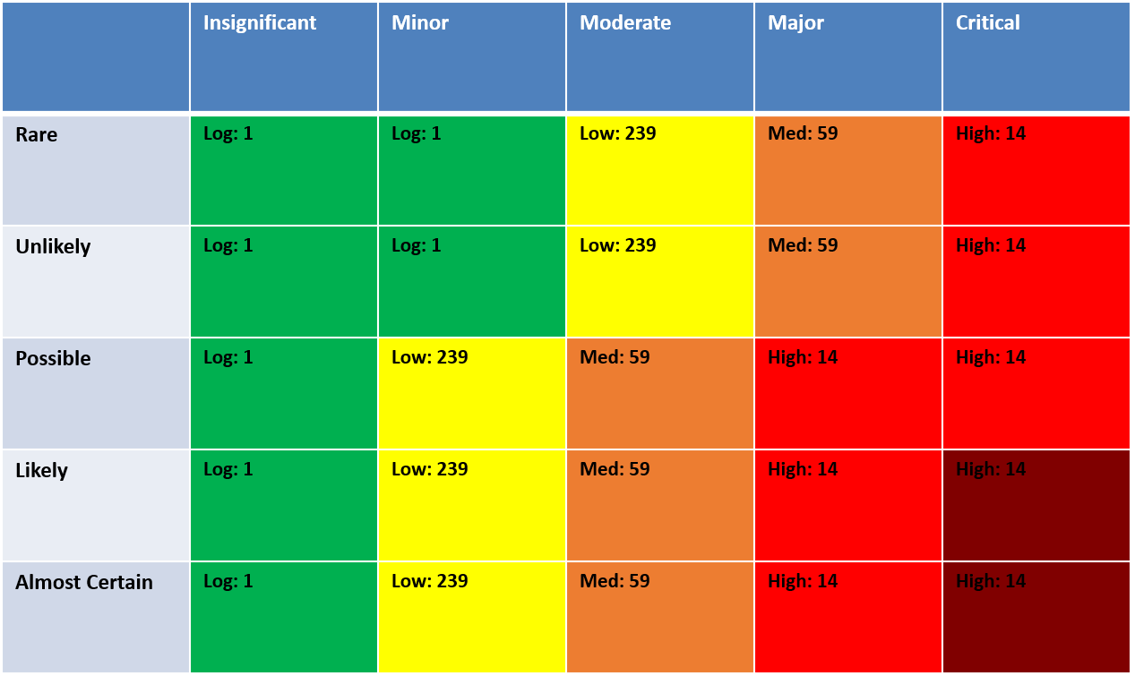
Risk Management Matrix for 197.168.57.30
Severity
Likelihood ↓ / Severity → | Insignificant | Minor | Moderate | Major | Critical
Almost Certain | 🟢 Very Low | 🟡 Low | 🟠 Medium | 🔴 High | 🔴 Extreme
Likly | 🟢 Very Low | 🟡 Low | 🟠 Medium | 🔴 High | 🔴 Extreme
Possible | 🟢 Very Low | 🟡 Low | Medium | 🔴 High | 🔴 High
Unlikely | 🟢 Very Low | 🟢 Very Low | 🟡 Low | 🟠 Medium | 🔴 High
Rare | 🟢 Very Low | 🟢 Very Low | 🟡 Low | 🟠 Medium | 🔴 High
These are the findings from our recent penetration test on TARGET 197.168.57.30, highlighting identified vulnerabilities, successful exploitation methods, and proposed remediation strategies. Our goal is to provide a clear understanding of your current security posture and actionable steps to enhance your defenses.
Likelihood
Notes:
Slides 12–15: Risk Matrix & Analysis
The risk matrix helped us assess vulnerabilities based on likelihood and severity. Severe vulnerabilities with high likelihood need to be prioritized for remediation.

Slide 14
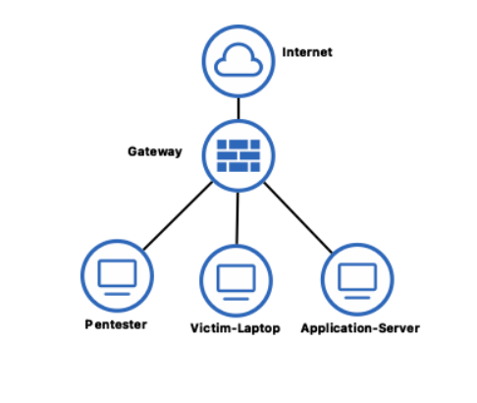
Risk Management Matrix
Likelihood vs. Severity based on Vulnerability Scan TARGET 197.168.57.30 and 192.168.57.20
Penetration Test Results & Remediation Priorities based on scanning the network infrastructure
Here’s the Risk Management Matrix created from the vulnerabilities in the scan report:of 192.168.57.30
8 vulnerabilities fall under Severe Impact + Almost Certain Likelihood (highest risk)
2 vulnerabilities fall under Major Impact + Likely Likelihood.
Notes:
Slides 14: Risk Matrix & Analysis. This is the network infrastructure we are scanning. We are scanning victim-laptop (197.168.57.20),application server., router and switches within the network. After scanning the victim machine, we found eight vulnerabilities in the ‘severe impact + almost certain likelihood’ quadrant, which represent the highest risks, and two major vulnerabilities with likely likelihood. These findings guided our remediation priorities.

Slide 15
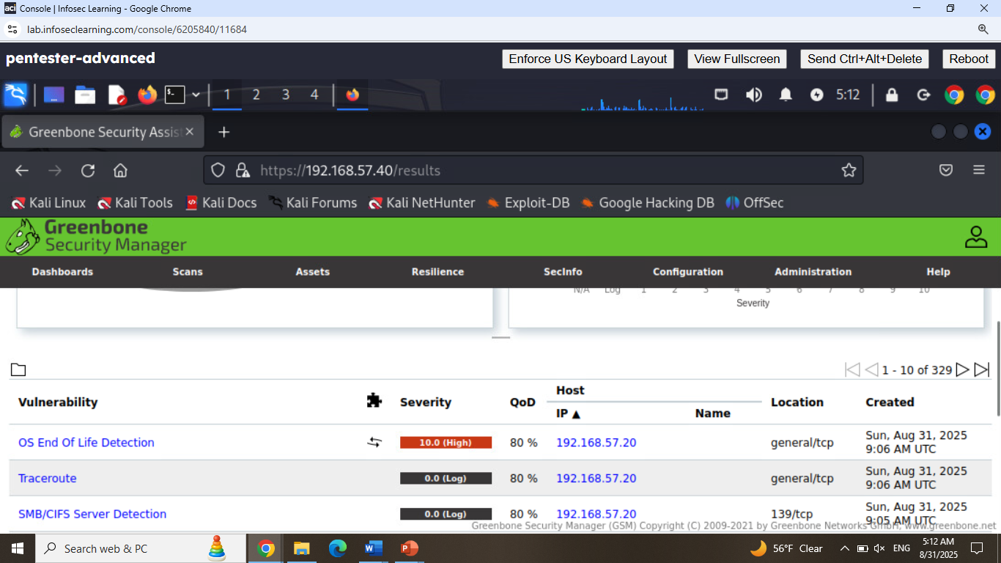
Scanning results of 192.168.57.20 at 80% QoD shows OS End of Life vulnerability
Notes:
Slides 12–15: Risk Matrix & Analysis
Scanning results were filtered out based on QoD.quality of detection score We have QoD set at 80% and above to show more reliability of the test. High QoD indiacates a more reliable finding.

Slide 16
Web Application & Password Security: Exploitation & Reporting
Part 2: Web Application Security Testing (DVWA)
Targeted web application security testing was conducted against DVWA (Damn Vulnerable Web Application) to assess TechShield's resilience against common web attack vectors.
1
SQL Injection (SQLi) Success
2
Cross-Site Scripting (XSS) Analysis
Successfully manipulated database queries to extract sensitive user IDs (e.g., admin, Gordon), demonstrating a critical data exposure vulnerability.
Malicious scripts were injected; client-side pop-up occurred, Indicating weak client-side protection
3
Command Injection Resilience
4
File Inclusion Testing
Attempts to execute system commands like whoami and ls -la yielded successful attack, suggesting command injection protections are not in place.
Tests for both local and remote file inclusion vulnerabilities noted that the security level was set to high, and PHPIDS (PHP Intrusion Detection System) was disabled, indicating potential risks under specific configurations.
Notes:
Slides 16–21: Web Application Testing
We also tested TechShield’s applications using DVWA, focusing on SQL injection, cross-site scripting, command injection, and file inclusion.

Slide 17
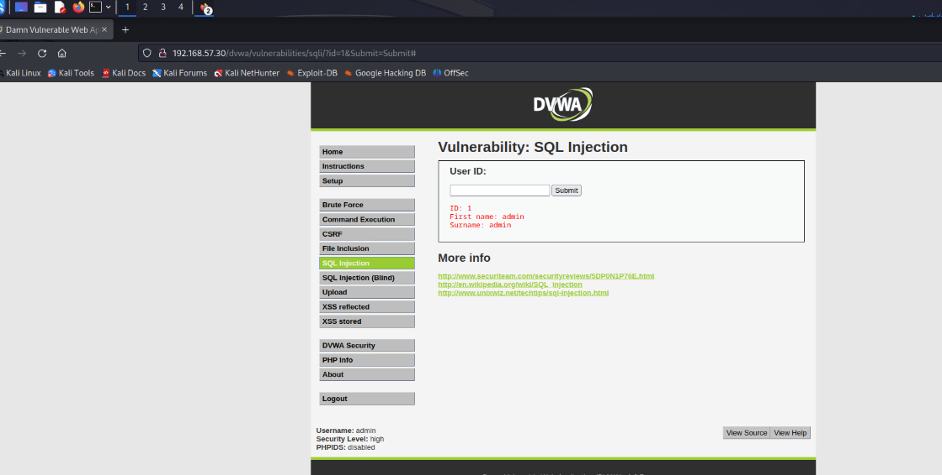
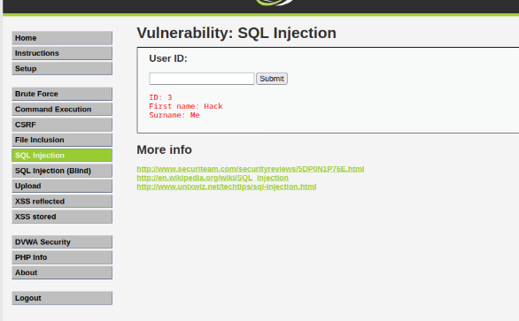
Web Application Vulnerabilities : SQL injection
A critical SQL Injection vulnerability was identified in a web application accessible from the internal network. This screenshot confirms the successful exploitation, demonstrating unauthorized database access. Such flaws can lead to data breaches and system compromise.
Notes:
Slides 17–21: Web Application Testing
SQL injection was confirmed, allowing unauthorized access to sensitive data. This screenshot confirms the successful exploitation of the database. These flaws can lead to data breaches and system compromise.

Slide 18
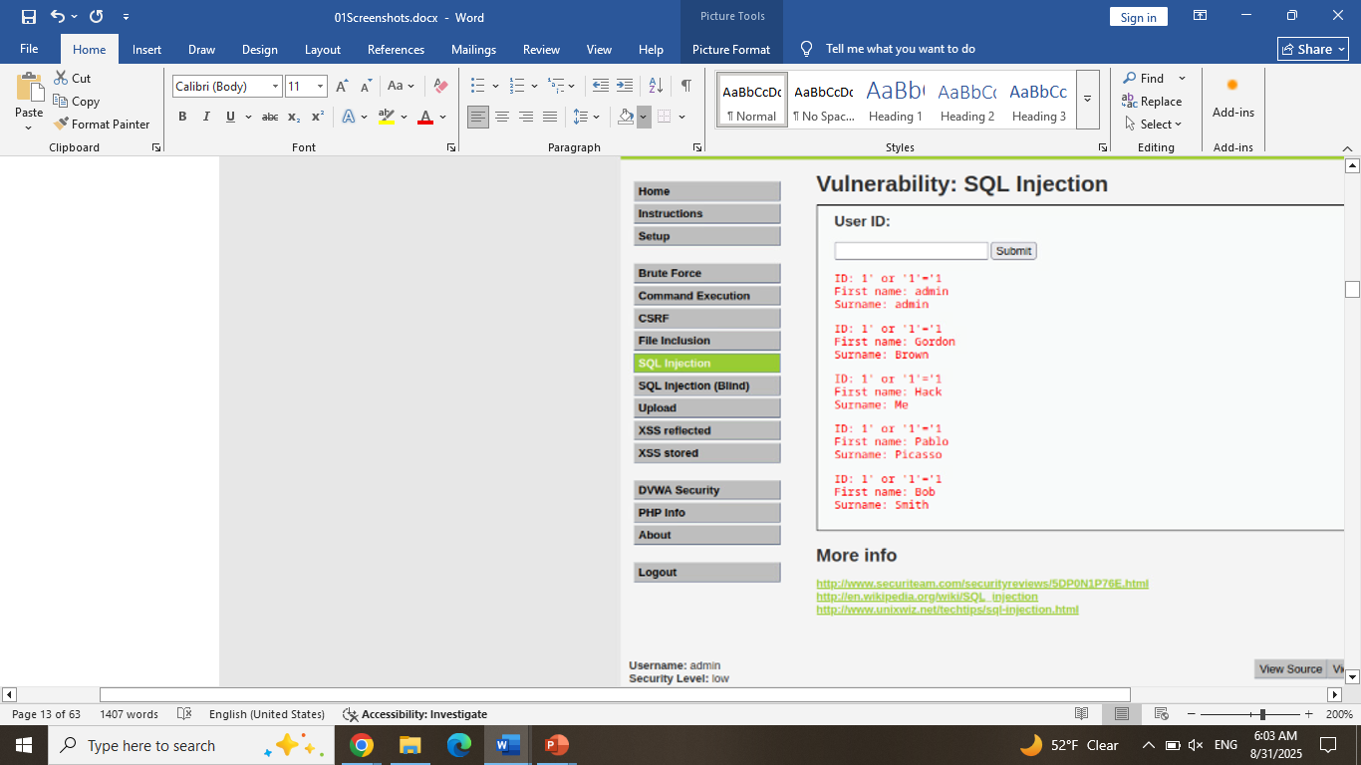
Vulnerability Spotlight: SQL Injection
SQL Injection is a common attack that exploits vulnerabilities in database queries. By injecting malicious code into input fields, attackers can trick the database into revealing more information than intended. This is often achieved by appending a tautology (e.g., 'OR 1=1') to a legitimate query. This forces the query to always evaluate as true, bypassing authentication or returning entire datasets rather than specific entries.
Key Takeaway: SQLi exploits flawed input validation, leading to unauthorized data access and manipulation.
Notes:
Slides 17–21: Web Application Testing
We confirmed here that malicious actors can trick the database into revealing sensitive information.

Slide 19
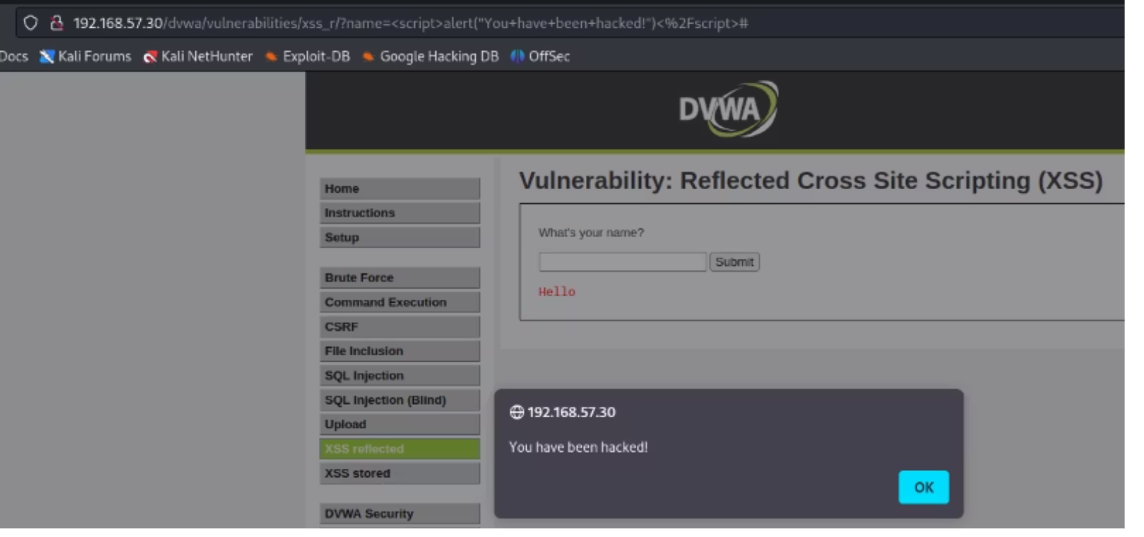
Vulnerability Spotlight: Cross-Site Scripting (XSS)
Cross-Site Scripting (XSS) attacks inject malicious client-side scripts into web pages viewed by other users. When we lowered DVWA security, a simple script: <script>alert("You have been hacked!")</script> successfully executed, triggering a pop-up alert.
This confirms the web application's susceptibility to XSS, allowing attackers to hijack user sessions, deface websites, or redirect users to malicious sites.
Severity: XSS can lead to credential theft, session hijacking, and defacement. Always sanitize user input!
Notes:
Slide 19: A pop alert on the screen confirms the web application’s susceptibility to cross site scripting. Cross site scripting can lead to credential stealing, session hijacking and defacement. Input sanitization is recommended.

Slide 20
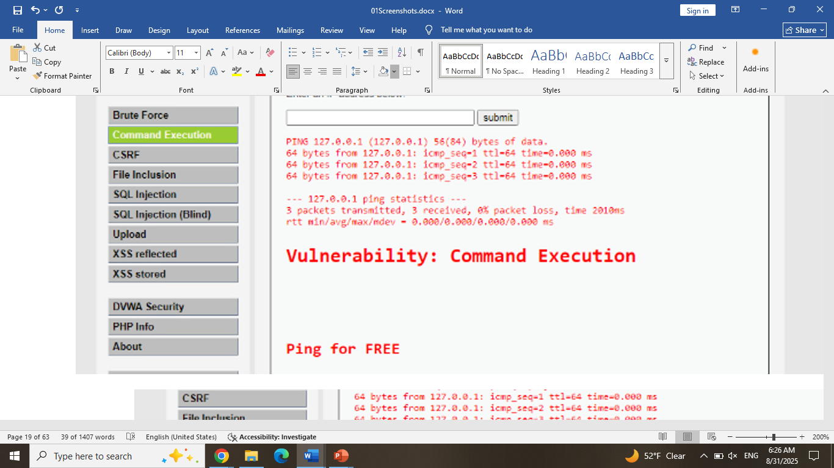
WEB APPLICATION SECURITY TESTING
Targeted DVWA
Tested for:
SQL Injection → confirmed vulnerable
XSS → executed successfully
Command Injection → executed '127.0.0.1; ls -la'
File Inclusion → checked remote/local file inclusion
This above command caused the website to perform a ping operation against a remote system. The loopback IP address is used to minimize the time involved in performing the ping operation so that the injected command will execute faster
Notes:
Slides 17–20: Web Application Testing
We also tested TechShield’s applications using DVWA, focusing on SQL injection, cross-site scripting, command injection, and file inclusion. SQL injection was confirmed, allowing unauthorized access to sensitive data. Similarly, XSS and command injection vulnerabilities were exploitable, proving critical weaknesses.

Slide 21
Exploiting Vulnerabilities: A Practical Overview
This section explores common attack methodologies used to exploit identified vulnerabilities, covering password cracking, payload injection, and the outcomes of successful exploitation. We'll also briefly touch on the role of forensic analysis.
1
2
Password Cracking (Hydra)
Payload Injection (Metasploit)
Brute-forcing credentials.
Delivering malicious code.
3
4
Exploitation Outcome
Forensic Analysis (Autopsy)
Gaining system access.
Post-incident investigation.
Notes:
Slide 21:We will be going over common attack methodologies used to exploit the target machines and their outcomes

Slide 22
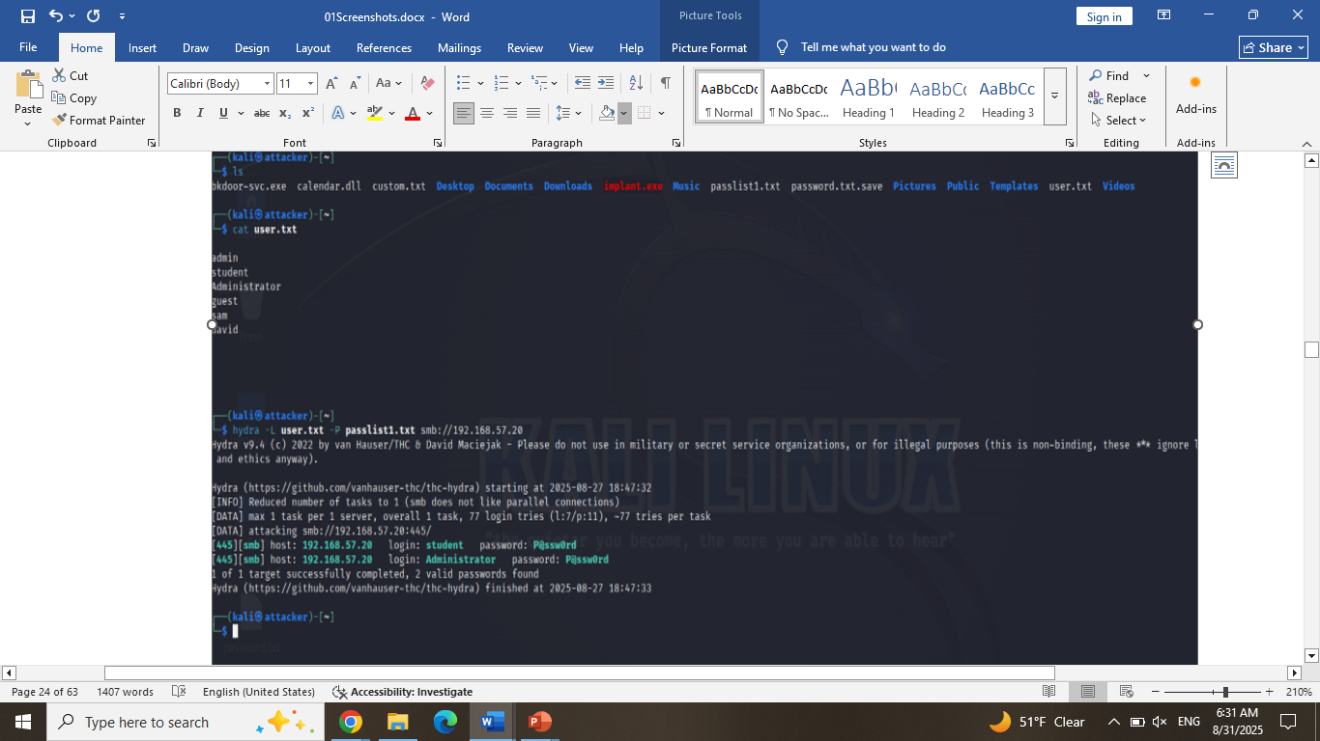
Password Cracking (Hydra)
Hydra successfully identified weak passwords, underscoring the critical need for organizations to enforce stronger password policies. This often means requiring longer, more complex passwords and regular rotation.
Best Practice: Implement password hashing, salting, and rate limiting to deter brute-force attacks.
Notes:
Slides 21–26: Exploitation & Forensic Evidence
To simulate real-world attacks, we performed password cracking with Hydra successfully gaining system access.

Slide 23
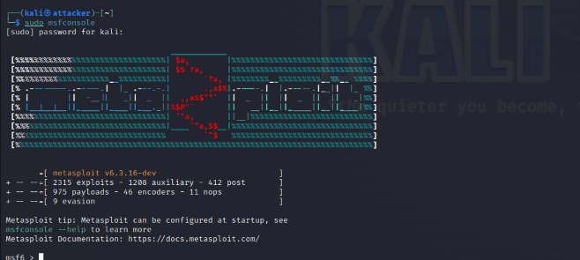
METASPLOIT- Initial Steps – msfconsole
Notes:
Slides 21–26: Exploitation & Forensic Evidence
We performed payload injection with Metasploit, successfully gaining system access

Slide 24
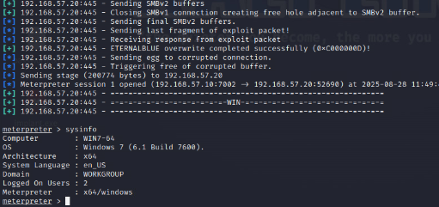
Payload Injection (Metasploit)
Using Metasploit, maclicious payload was generated and deployed tailored to exploit identified DVWA vulnerabilities. This process effectively demonstrates an attacker's ability to compromise systems by injecting code that executes arbitrary commands.
Successful payload injection leads to complete system compromise, data exfiltration, or persistent access.
Notes:
Slides 22–26: Exploitation & Forensic Evidence
Meterpreter sessions allowed us to gather OS details and escalate privileges.

Slide 25
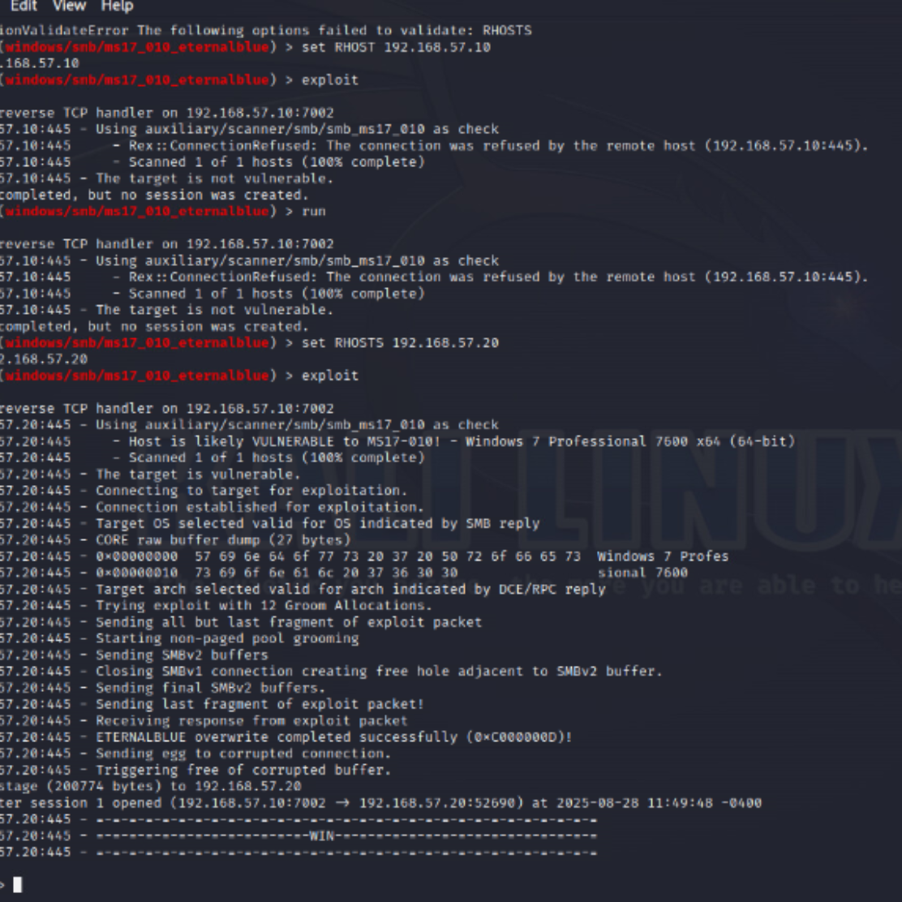
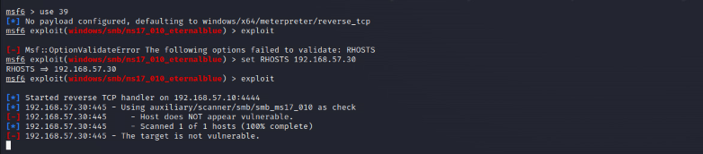
Metasploit & Meterpreter: Post-Exploitation
After a successful exploit, Meterpreter provides an advanced payload that allows deep interaction with the compromised system. We successfully opened a Meterpreter session and gathered critical OS details using the `sysinfo` command, including system architecture, operating system, and uptime.
This capability allows attackers to understand their environment, escalate privileges, and pivot to other systems on the network.
Notes:
Slides 22–26: Exploitation & Forensic Evidence
Screenshots of successful exploit using Metasploit.

Slide 26
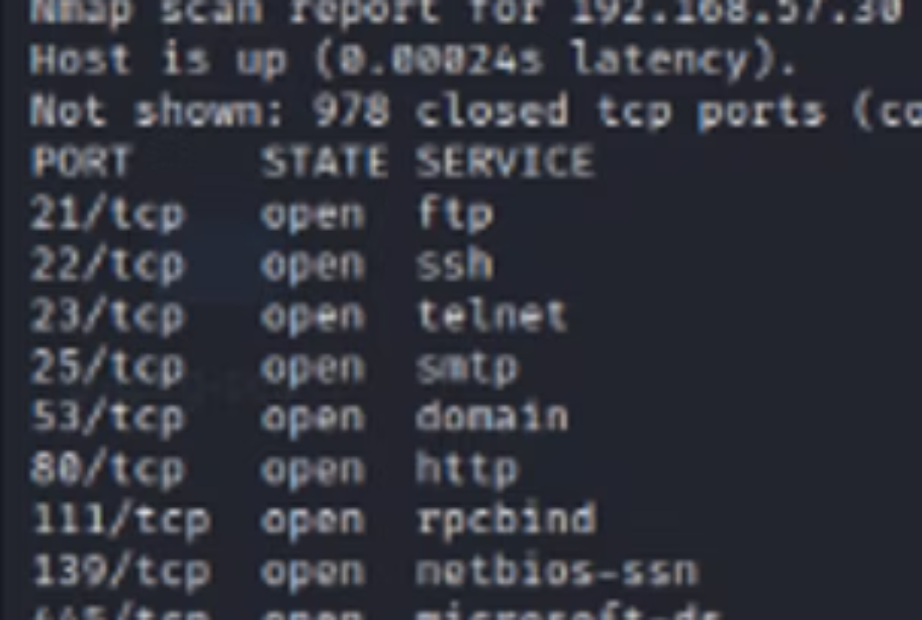
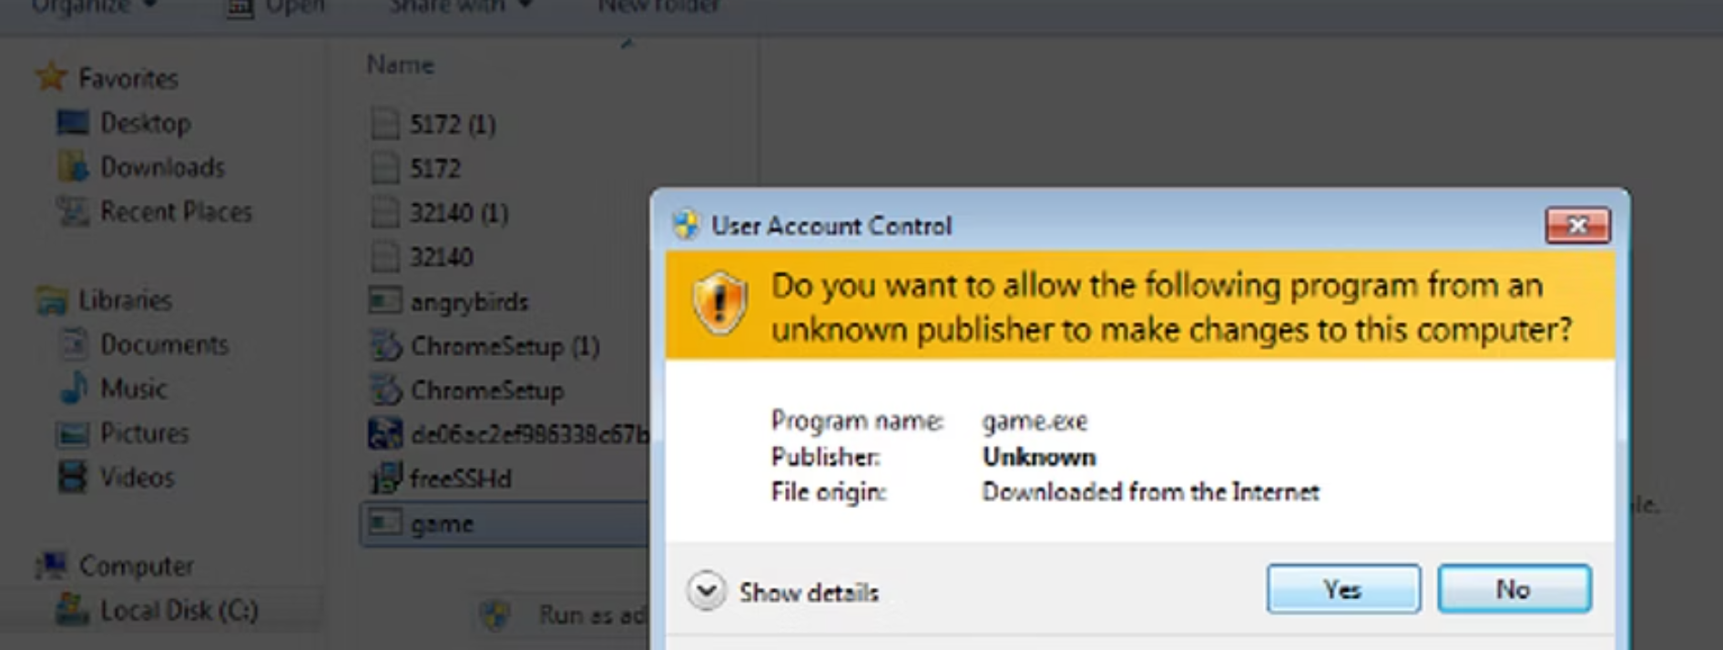
Visual Evidence: Key Findings & Exploitation
Below are screenshots illustrating critical stages of our penetration testing, from initial discovery to successful exploitation and forensic analysis. These visuals serve as concrete evidence of identified vulnerabilities and the impact of their potential exploitation.
Notes:
Slides 26: Exploitation & Forensic Evidence
These are a few screenshots provided as a visual evidence of successful exploitation of the network structure.

Slide 27
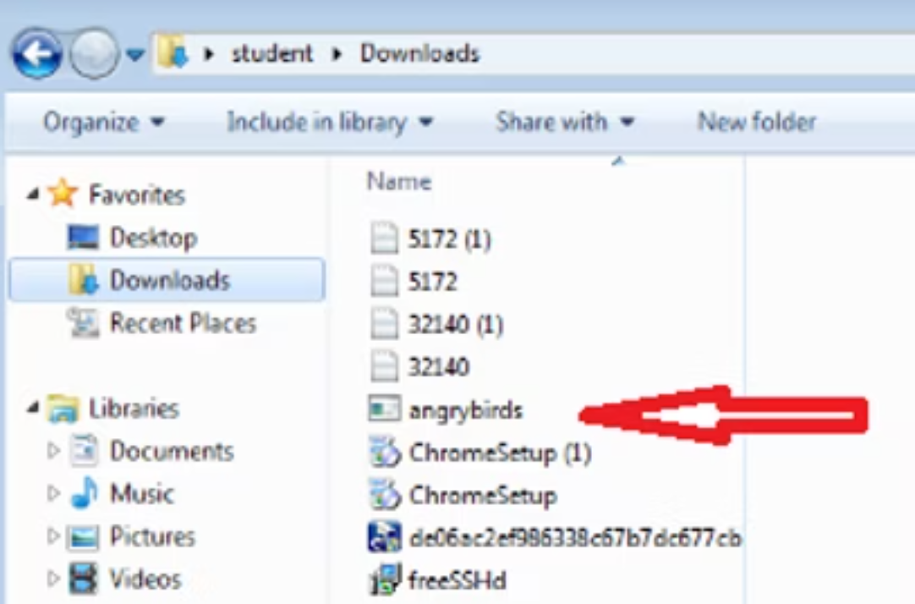

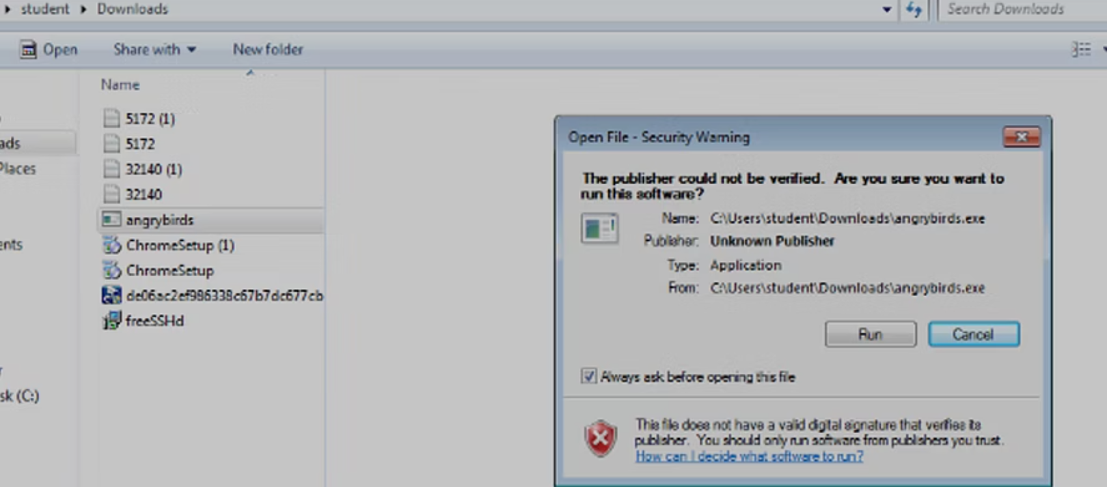
Payload Execution & System Compromise
Following the successful social engineering attack, the malicious payloads executed, granting unauthorized access and control over the compromised systems. These images document the post-exploitation phase, demonstrating the extent of system access gained.
Notes:
Slide 27: We compromised the target machine using a social engineering technique and tricked the used in downloading malicious file.

Slide 28

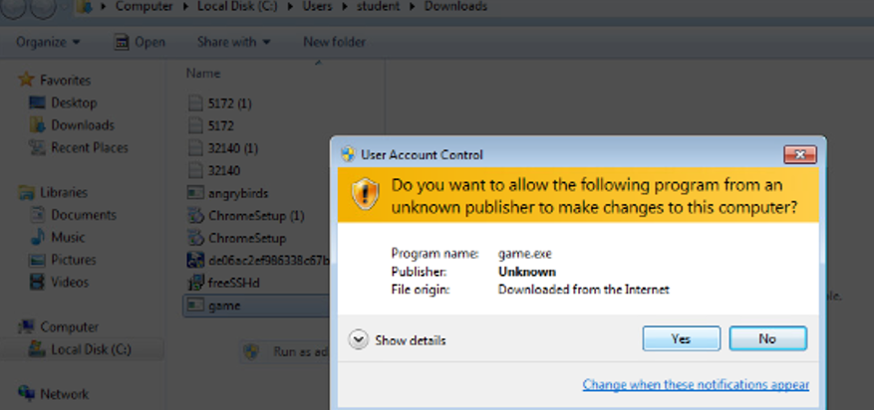
SOCIAL ENGINEERING ATTACK
Uploaded malicious file “game.exe” and “angrybirds.exe” through wetransfer and then sent it to victim through a phishing attack. Victim ran these malicious files on their machines. Below are the screenshots
Notes:
Slide 28: Another screenshot of second file downloaded on the target machine

Slide 29
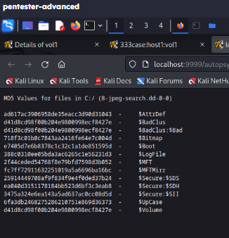
MD5 Values for Files
As part of the integrity check and evidence collection, we calculated the MD5 hash values for key files found on the compromised system, specifically within an 8jpeg image file. These hashes ensure the authenticity and unaltered state of the collected digital evidence.
Notes:
Slide 29: Forensic analysis, using Autopsy, verified evidence integrity through MD5 hashes.

Slide 30
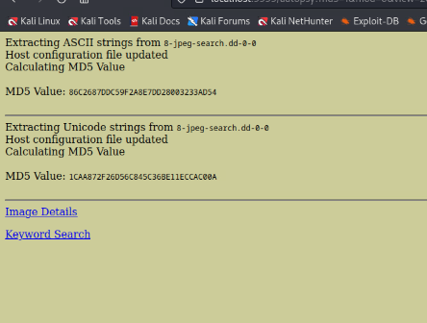

Forensic Image Verification
The integrity of the forensic image obtained from the compromised system was verified using its MD5 hash value. The calculated hash matches the expected value, confirming that the digital evidence is complete and unmodified.
The MD5 of the Forensic image should be 9bdb9c76b80e90d155806a1fc7846db5. It matches.
Notes:
Slide 30: We performed forensic image verification and confirmed that the digital evidence is unmodified..

Slide 31
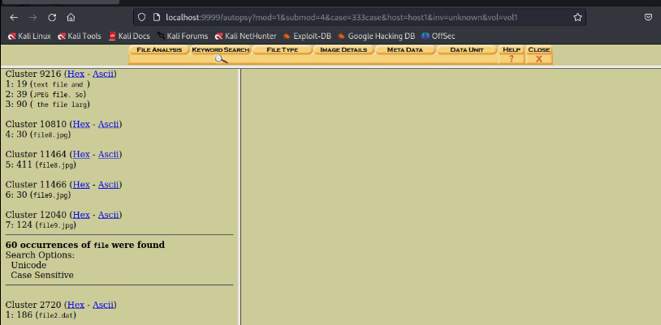
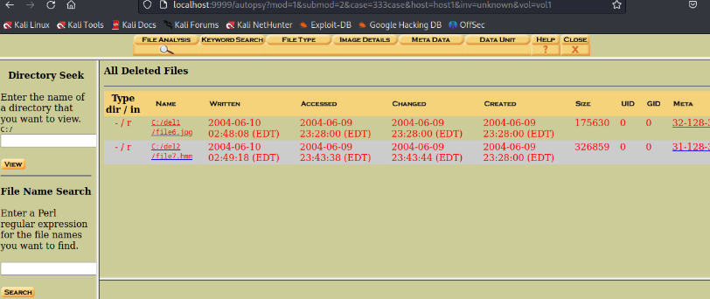
Recovered Deleted Files; file1.jpg, file9.jpg etc
During the forensic analysis, we successfully recovered several deleted files from the compromised system, including potentially sensitive documents. This highlights the importance of secure data sanitization policies.
Notes:
Slide 31: We also recovered deleted files, emphasizing the risks of poor sanitization

Slide 32
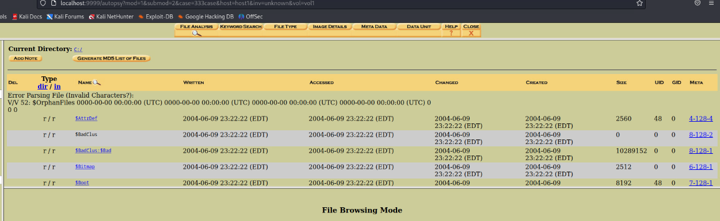

Slide 33
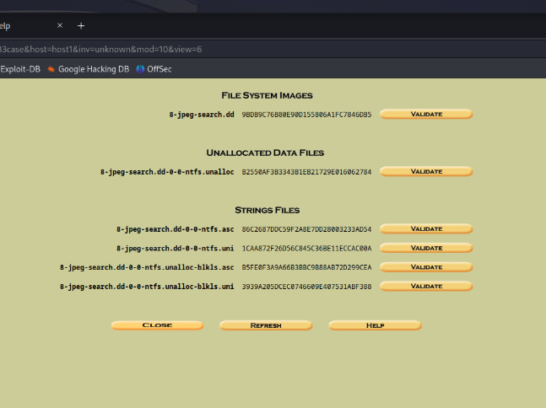
Forensic analysis

Slide 34
Note: The MD5 of the Forensic image should be 9bdb9c76b80e90d155806a1fc7846db5. It matches
Extracting strings

Slide 35

Challenges Faced
Network filtering and firewall blocking certain scans.
DVWA security levels preventing some attacks.
Resolved by adjusting scan techniques and testing environment configuration.
Successful social engineering attempts after using various techniques to attack the target e.g phishing
Metasploit; Locating the correct payload based on the type of victim machine
Notes:
Slide 35: Challenges Faced
We faced several challenges, including firewall rules blocking scans and DVWA’s security levels preventing certain attacks. These were resolved by adjusting scan techniques, modifying the test environment, and carefully selecting payloads for Metasploit. Social engineering attempts, such as phishing, also demonstrated potential risks.

Slide 36

Areas of improvement
Continuous monitoring and periodic vulnerability scanning.
Harden web servers and databases before testing.
Implement automated exploitation prevention measures.
Document all tests with screenshots and logs in real-time.
Notes:
Slide 36: Areas of Improvement
Looking ahead, TechShield should implement continuous monitoring, regular vulnerability scans, and stronger hardening of servers and databases. Automated exploitation prevention and detailed real-time documentation during testing will also improve resilience.

Slide 37

Summary /Conclusion
Identified multiple critical and high-risk vulnerabilities.
Demonstrated exploitation potential and provided remediation recommendations.
Forensic evidence collected validates findings.
Security posture improvement suggested through remediation and periodic assessment.
Notes:
Slide 37: Conclusion
In summary, our penetration test identified multiple critical vulnerabilities, demonstrated real exploitation potential, and collected forensic evidence to validate findings. With the recommended remediation and ongoing assessments, TechShield can significantly improve its security posture. Thank you.

